Slide 1




KA2-Cooperation for Innovation and the Exchange of Good Practices Strategic Partnership for School Education
Ministry of National Education,
Erdem Bayazıt Anatolian High School, GÖLBAŞI/ANKARA

Slide 2

STRIDE- Strategies for the Digital Education
Erdem Bayazıt Anatolian High School-
Turkey

Slide 3
Partner Organizations/Countries:
Instituto di Istruzione Superiore Professionale Via Pedemontana- Italy
CONSORZIO-ROMA- Italy
Universitatet BREMEN-Germany
Inercia Digital S.L.-Spain
Galway and Roscommon Education&Training Board-Ireland
Erdem Bayazıt Anatolian High School-Turkey
Zespol Szkol w Jankowie Przygodzkim-Poland
We are happy to work with you ☺

Slide 4


Turkey is a developed country with its educational and business opportunities and tourist attractions all over the country.

Slide 5
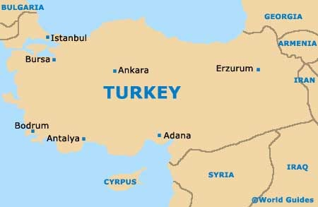
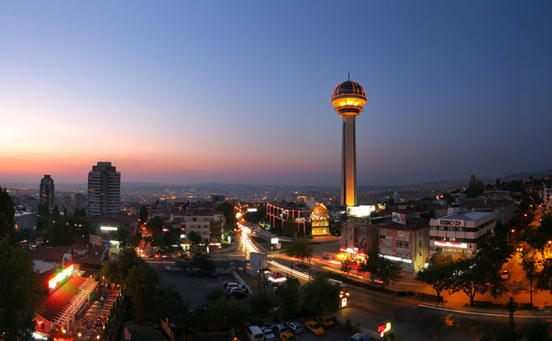
Ankara(Capital city of Turkey)
A modern city with lots of facilites of education more than 200 public and private schools and 10 public and 8 private universities.

Slide 6
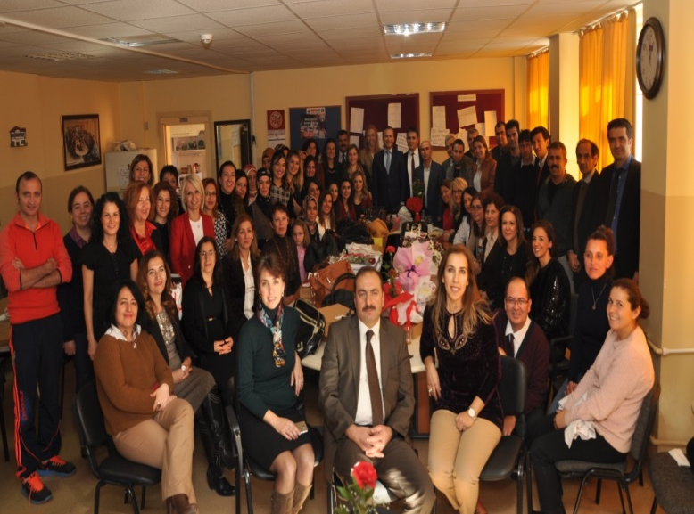
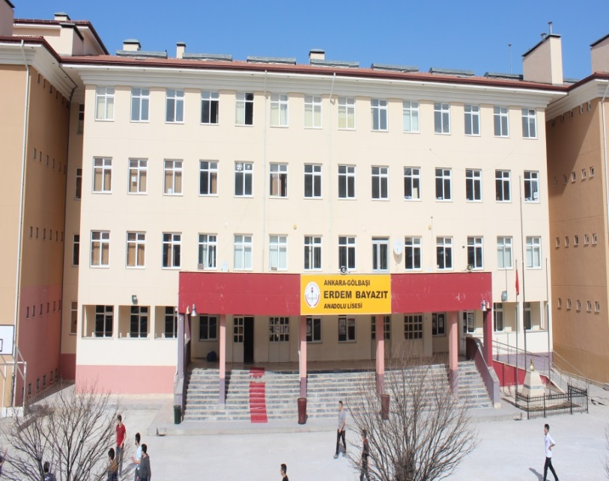
Erdem Bayazıt Anatolian High School
a foreign language based public high school
1000 students aged 14-17 and 70 teachers.
Our aim is academic success at university
Our school is located in Gölbaşı, a nice district of Ankara, the capital city of Turkiye.

Slide 7
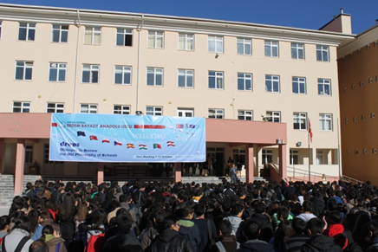
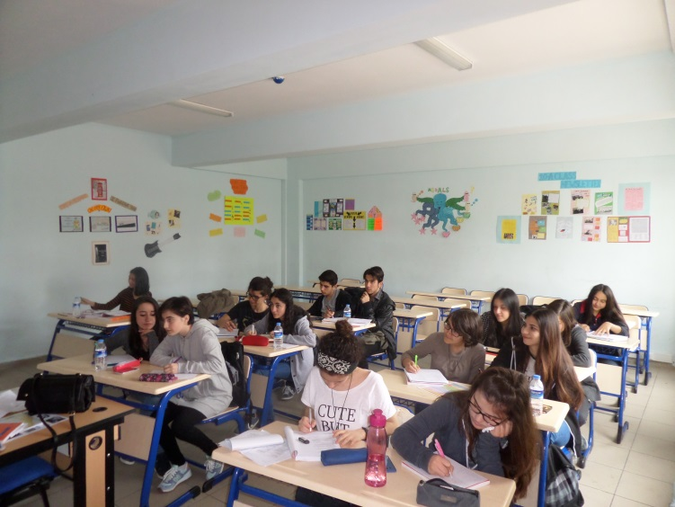
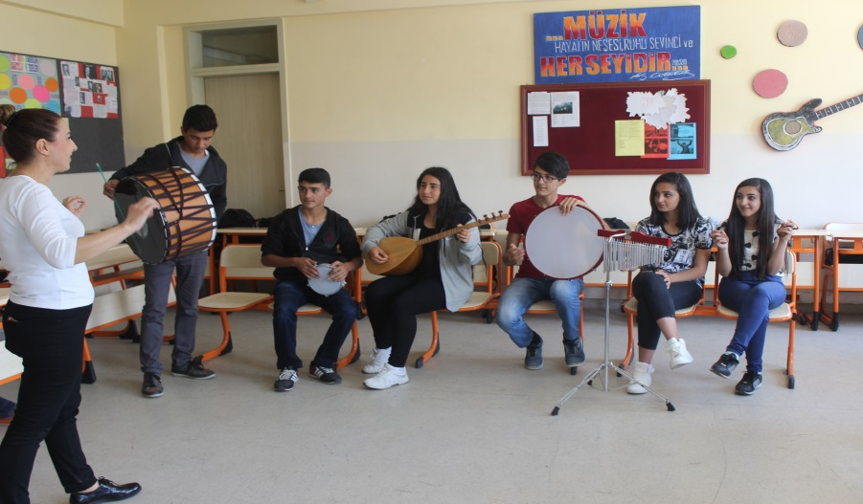
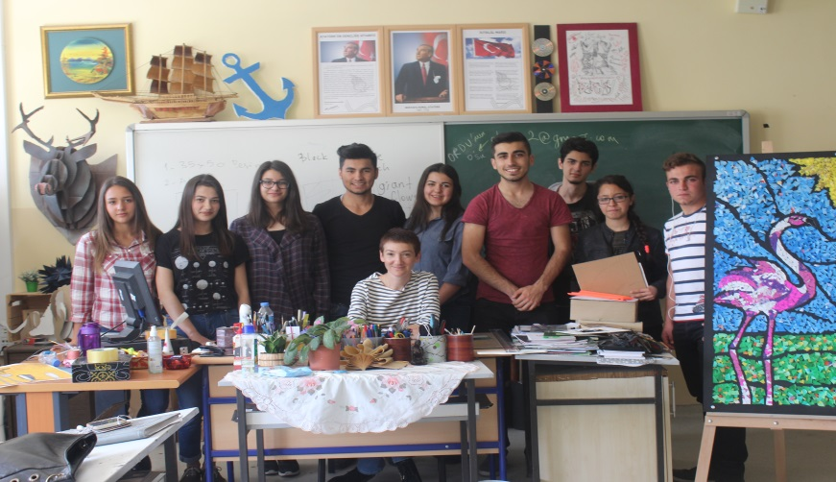

Slide 8
ACTIVITIES WHICH WE COMPLETED WITHIN THE PROJECT STRIDE
Our teachers and students answered the questionnaires which show the actual state of digitization in Erdem Bayazıt High School.
We attended the 1st meeting in Italy and prepared a report containing the details of survey and evaluation of the meeting.
We organized a focus group regarding the State Analysis Report and the Training Path. We prepared the second report and collected other partners’ reports as the leader of the activity.

Slide 9
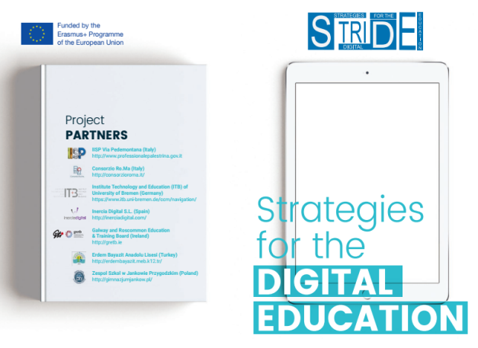
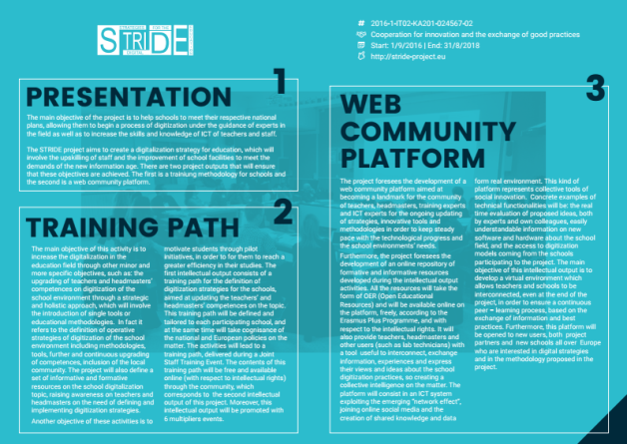
ACTIVITIES WHICH WE COMPLETED WITHIN THE PROJECT STRIDE
Dissemination : We started multiplying by using
  leaflet
  web article on school website
  article on local newspaper
We also read the first e-newsletter with our teachers and students.

Slide 10

BY THE HELP OF THE PROJECT STRIDE;
SO FAR,
We have raised awareness of the ICT use in education among students and teachers
We have had a clear idea to what extend we use digital media and what aspects we need to improve.
We have had an onset to organize our plans
about digitization systematically
We have had practical aims of digitization for
our school and country

Slide 11
THE RESULTS OF INQUIRIES FOR TEACHERS AND STUDENTS ACCORDING TO STATE ANALYSIS REPORT
In the 1st week of October, 49 students and 13 students involving 9 language, 4 socio- cultural, 1 MINT, 1 administrative staff filled the questionnaire.

Slide 12
The data obtained from students showed that
Students are familiar with with the technology in class and media competence
They believe that digital devices will be more important in next 10 years
For their work organization, they use MS office and presentation tools effectively

Slide 13
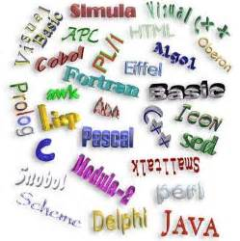
They usually use e-mail addresses to share information
Nearly all of them use Facebook but they don’t prefer using Wiki or blogs
Some of them think their best way of learning
is taking notes during lessons
Most of them are unfortunately not good at
programming languages
but they are willing to learn

Slide 14

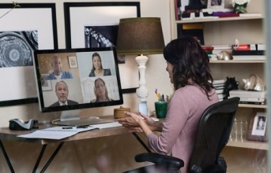
The data obtained from teachers showed that
Teachers try to use digital media in their teaching proffession and private lives
Most of them use smart phone applications to communicate with students and their parents
They use proffessional on-line communities or forums to reach other colluages

Slide 15


Nearly all of them believe that digital devices will be more important in next 10 years
They mostly use presentation tools and MS office for their
work organisation
They effectively use
digital media for the
preparation of the lessons

Slide 16

ICT tools are mostly used under the control of teachers and less given to the students
Briefly, teachers reflect positive attitudes towards the implementation of digital media

Slide 17
FOCUS GROUP

Slide 18
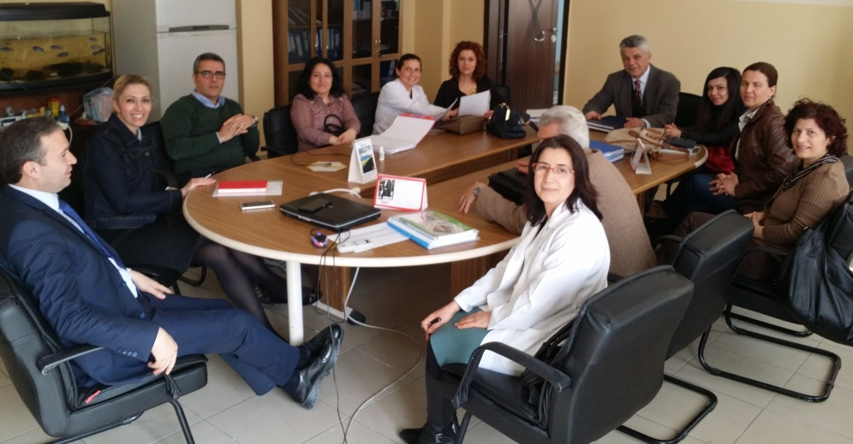
FOCUS GROUP DEATAILS
We had one focus group involving 33 participants;
15 students’ representatives,
11 teachers,
1 secretary staff,
1 headmaster,
2 administrative staff,
2 consultant,
1 ICT teacher,

Slide 19

Questionnaire with 3 classes
Before getting together for the focus group, we prepared a short questionnaire consisted of the following questions in 3 classes from different grades(9th, 10th,11th ) that have 34 students each.

Slide 20

We asked to the student
What do you think about the use of DM at school ? What are the advantages and disadvantages?
If you had a chance to attend a training on DM , what would you like to learn?
In your opinion, what are the most important competences about using DM that your teachers must have?

Slide 21
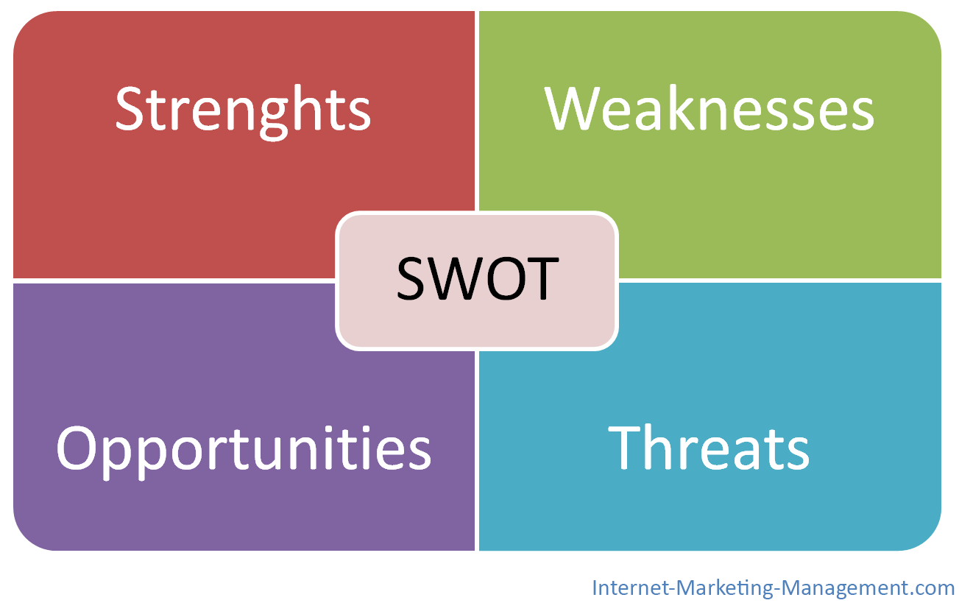
We made a SWOT anlaysis according to the survey and discussion of focus group

Slide 22

Strengths:
First, using DM in lessons provides better learning with visual and audial aids than traditional methods.
It is easier to teach and learn via interactive board and online lessons. Students have little difficulty in reinforcing gained knowledge by the online lessons.

Slide 23
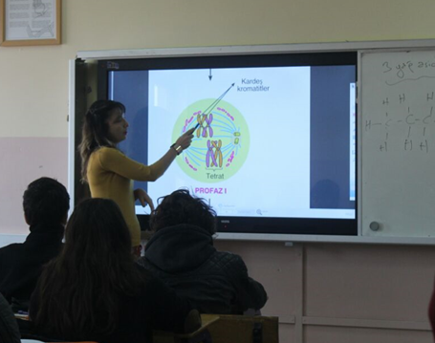
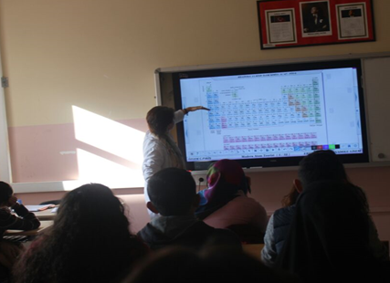
Strengths:
it saves time for teachers and students because they don’t have to write or draw anything on the board. The teachers have opportunity to save all the documents on the board and to use them whenever needed.
both teachers and students reach educational materials quickly and easily.

Slide 24
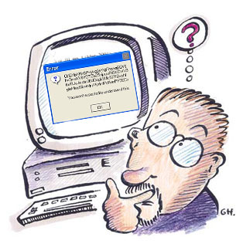
Weaknesses:
Sometimes interactive boards have some technical problems and we cannot use them. Trying to solve the problem wastes time.

Slide 25

Weaknesses:
For some lessons, it is difficult to get student involved actively because only the teachers use the interactive board. They easily get bored.
Students expressed that some of the teachers get students listen or watch everything on the board or don’t make any necessary addition or explanation. There is no active use of students in class.

Slide 26

Students complain some of their teachers don’t have DM competence.
They are accustomed to use only traditional ways.

Slide 27
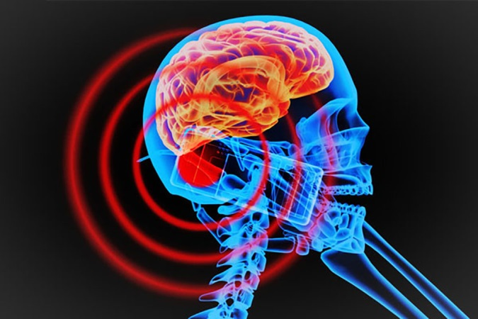
Weaknesses:
A number of students think that using DM causes health problems because they emit radiation and sitting in front of computer cause physical health problems.(eye, neck, back etc..)

Slide 28
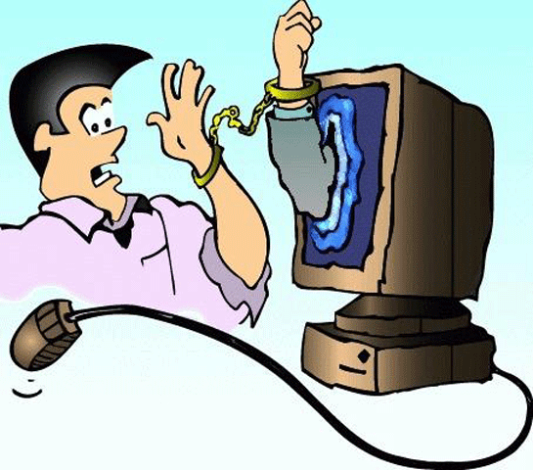
Weaknesses:
As it is mentioned State Analysis Report, a student commented on two questions concerning DM as a learning content ‘Responsibly use DM, but not it take over your life’. Some of the students have some problems about this. They got far away from educational objectives and begin to use just for entertainment. The students agree that use of DM is a step to addiction.

Slide 29
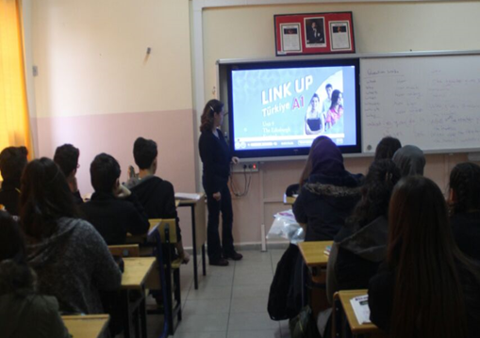
Opportunities:
Our school has interactive boards in each classes.
Language teachers always use the software of the coursebook.

Slide 30
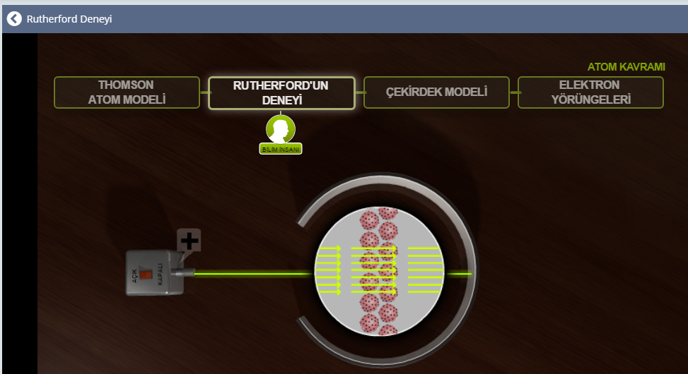
Opportunities:
We have internet connection. We have the chance to watch some scientific experiments online which are impossible to be done in class environment.

Slide 31

Threats:
There are data protection problems because of inadequate software. If you use it, we can not install anything on the smart board. İf you deactivate the protection you may
see new viruses that
causes serious
problems.

Slide 32

Threats:
Technical problems causes not only waste of time but also it hinders classroom management while trying to find solution.

Slide 33

Threats:
Because of the filtration on the smart boards’ internet connection teachers aren’t able to access web sites they need.

Slide 34
DURING JSTE
We agree on most of the training topics. Still, we defined the most important things we need to learn or improve
How to lead the students in appropraiate and safe use of digital media in their proffessional and private lives
See different examples from Europe
We need to learn and teach sudents programming languages as shown in State Analysis Report
How to develop an overall digitization strategy for our school

Slide 35
DISCUSSION OF LEADING QUESTIONS

Slide 36
1. Which points of the JSTE already meet your ideas?
  Introduction and Basics part is essential for us.
  Second day’s content ‘A new pedagogical view‘ attracts our attention because we are willing to learn how to lead students in any use of DM.
  Sharing exercises and examples among the participating countries is useful.
  We use digital media in our classes but still, the third day’s content “ How to use Digital Media in class “ can contribute to our ICT and media competence.
  In our school, we are not able use online-based work organization because of the connection and filtration restrictions. On the fourth day of training, we can mention these problems and we can brainstorm about how to handle the risks and problems.
  Data protection is important for our school as we have some problems in our classes.

Slide 37
2. Where do you see necessary adaptations?
If we are to add any necessary adaptations, in our school, there is a need for learning programming languages for students because the time schedule at Anatolian schools in Turkey offer only one hour course in a week at 9th degree that is really inadequate.

Slide 38
3. What contents of digitization issues are relevant for your school?
For Teachers,
Improving Basic ICT and Media competence is essential as they are accustomed to use traditional methods rather than innovative approaches in teaching. To decrease the difference between teachers’ and students’ ICT competences, Teachers have to learn to use DM.

Slide 39
3. What contents of digitization issues are relevant for your school?
For Students,
For students, there is a need for more attractive and more interesting tools for lessons. The teachers need well prepared and interactive materials. It will be useful for us to overview good examples and best practices in Case examples part of the JSTE.
Some of the students already use online tools at home. Online –based work organization part of the JSTE will also help the teachers organize the students‘ works.

Slide 40
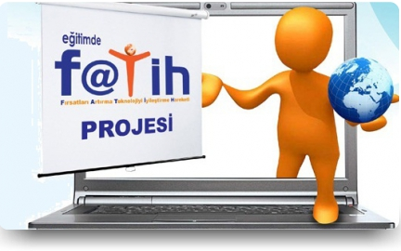
4. How do you define the main goal of your school’s digitization strategy?
Erdem Bayazıt Anatolian High school implements FATİH project objectives during digitization process which aims to offer equal opportunities to the students by using DM in classes. EBA as an example of OER platforms gives chance to
share information among all
teachers and students.

Slide 41
5: How do you define the role of the JSTE within the process of strategy development?
We all agree that we are going to get detailed information about how to develop a digitization strategy for our school, so JSTE is essential.
WE ARE LOOKING FORWARD TO TRAINING EVENT☺

Slide 42
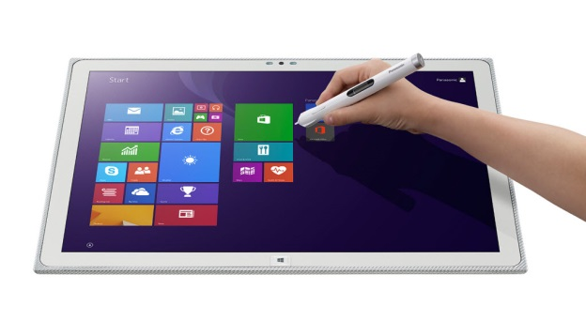
THANK YOU SO MUCH
☺
Ministry of National Education,
Erdem Bayazıt Anatolian High School, GÖLBAŞI/ANKARA
STRIDE PROJECT TEAM

